Slide 1
Research Presentation
Abhay Shastry

Slide 2
Agenda
About Me
Automatic Bone Age Assessment Using Deep Learning
Miami Dade Transportation sentiment analysis

Slide 3
About Me

Slide 4
Qualifications and Skills
Education
Master’s in Computer and Information Sciences, University of Florida (August 2024 - Present)
Bachelor’s in Computer Science, Dayananda Sagar University (August 2018 - June 2022)
Professional Experience
Machine Learning Engineer at Navan.AI (Remote, Singapore): Built computer vision models, cloud platforms, real-time inference APIs (TensorRT, Triton, FastAPI), fine-tuned GenAI models.
Software Developer Intern at Intel (Bangalore, India): Developed ETL pipelines and MapReduce jobs for manufacturing analytics.
Technical Skills
Deep Learning: TensorFlow, PyTorch, Hugging Face, OpenCV
Cloud/DevOps: AWS, Azure, GCP, Docker, Kubernetes
Languages: Python, Go, JavaScript

Slide 5
Automatic Bone Age Assessment Using Deep Learning

Slide 6
Project Overview
Goal: Predict pediatric bone age from left-hand X-rays.
Problem: Traditional methods (TW3, GP) are manual, time-consuming, error-prone. Traditional CNN based solutions are computationally inefficient
Solution: Use Deep Learning (Xception model) for fast, accurate predictions with Depth-wise Separable Convolution and Swish activations
Dataset: RSNA 2017 Pediatric Bone Age Challenge (12,611 X-rays).

Slide 7
Model Architecture and Innovations
Model: Xception Architecture
Depthwise Separable Convolutions:
Replaces heavy convolution operations.
Greatly reduces model size and training time without losing accuracy.
Activation Functions Compared:
ReLU vs Swish.
Swish is smoother, allows better gradient flow.
Input Preprocessing:
Images resized and normalized for stable training.

Slide 8
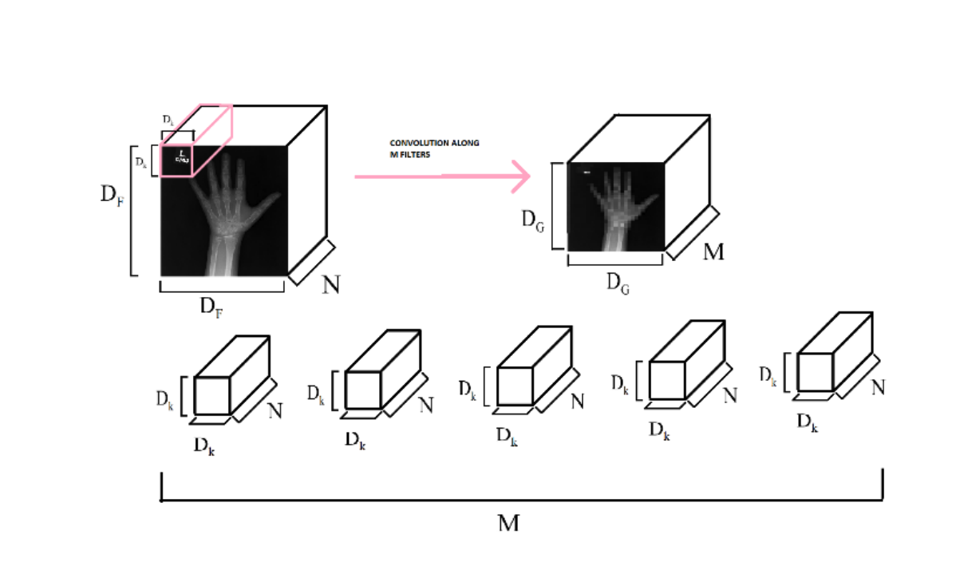
Traditional Convolution

Slide 9
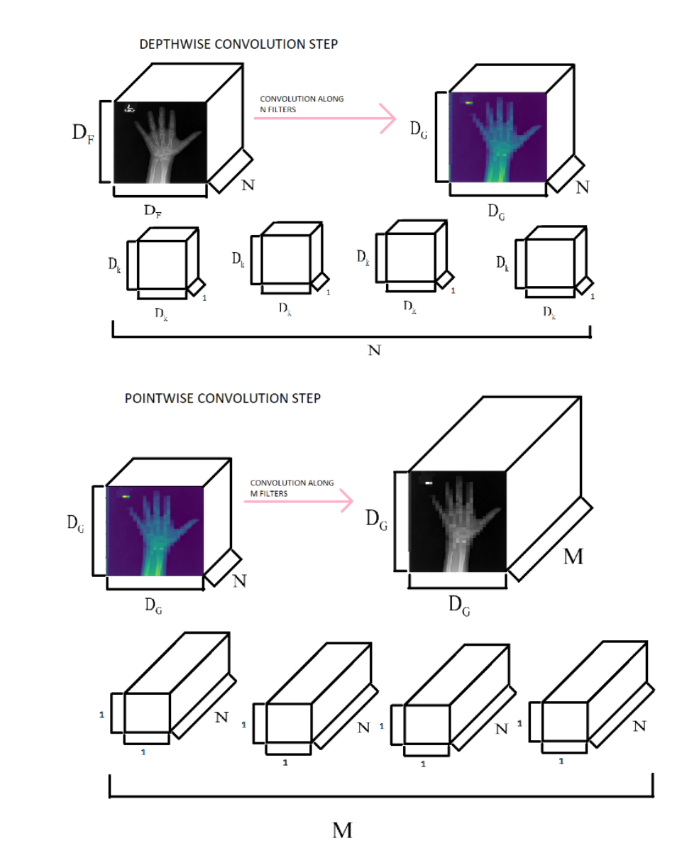
Depth-wise Separable Convolution

Slide 10
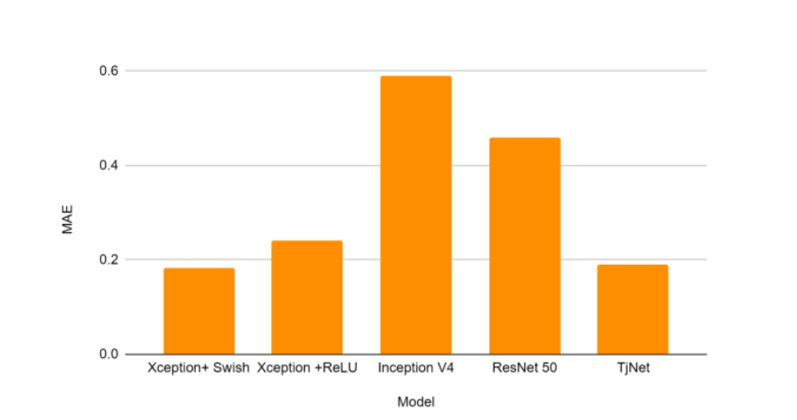
Results and Conclusion
Swish activation improved performance by 34.9%.
Xception model achieved lightweight yet high accuracy.
Activation Function | Validation Error | MAE(Years) | Accuracy
ReLU | 0.4518 | 0.2414 | 91.54%
Swish | 0.2367 | 0.183 | 96.33%

Slide 11
Miami Dade Transportation - Sentiment Analysis

Slide 12
Introduction
This POC explores performance of various sentiment analysis models on Miami Dade transit related tweets from the past 7 days
Models used:
Manual Analysis
TextBlob (rule-based)
VADER (social media-tuned)
BERT (binary classification)
Roberta (multi-class classification for Twitter)

Slide 13
Result
Method | Positive % | Negative % | Neutral % | Notes
Manual | 0.0 | 16.1 | 83.9 | Baseline
TextBlob | 18.8 | 6.2 | 75 | Overestimates positivity, underdetects negativity.
VADER | 34.4 | 12.5 | 53.1 | Better at detecting negatives, but still optimistic.
BERT | 15.6 | 84.4 | N/A | Better positivity detection
ROBERTA | 6.2 | 6.2 | 87.5 | Best match for Neutral dominance but slight negativity underestimation.

Slide 14
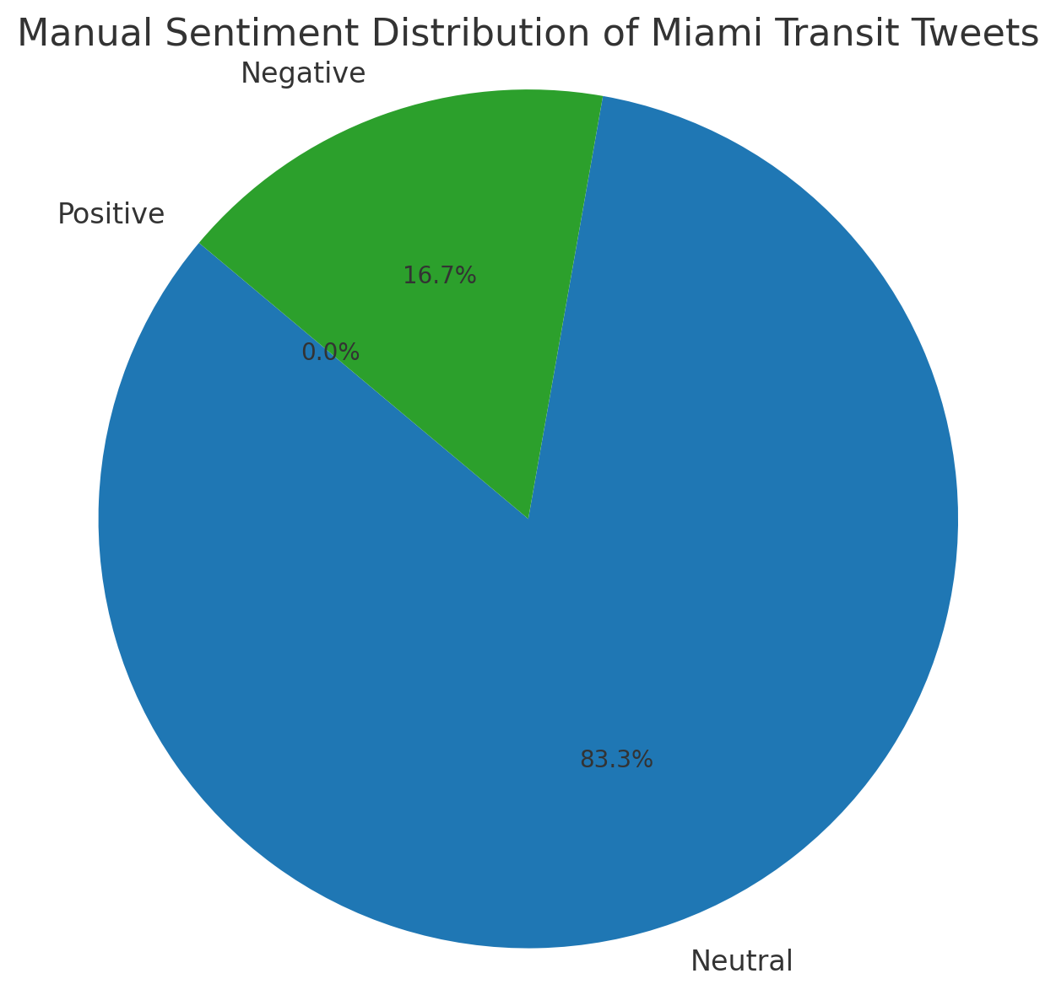
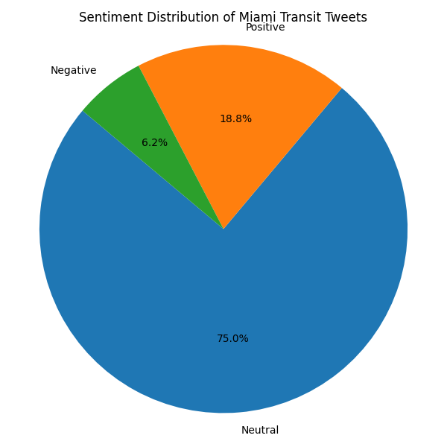
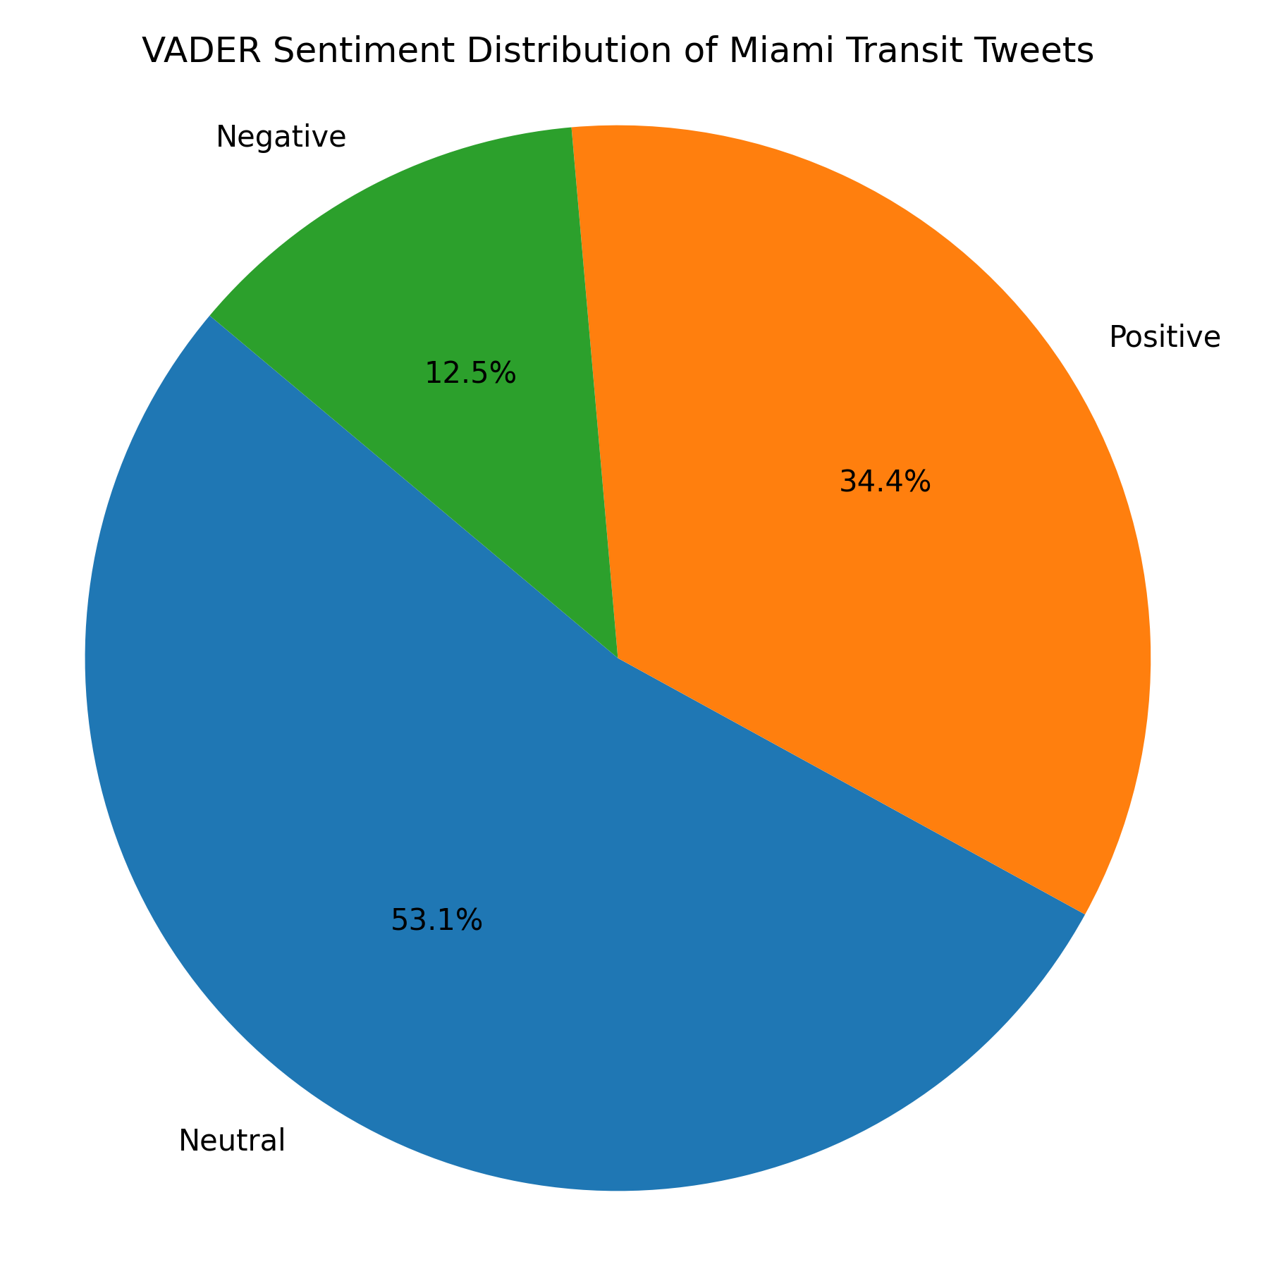
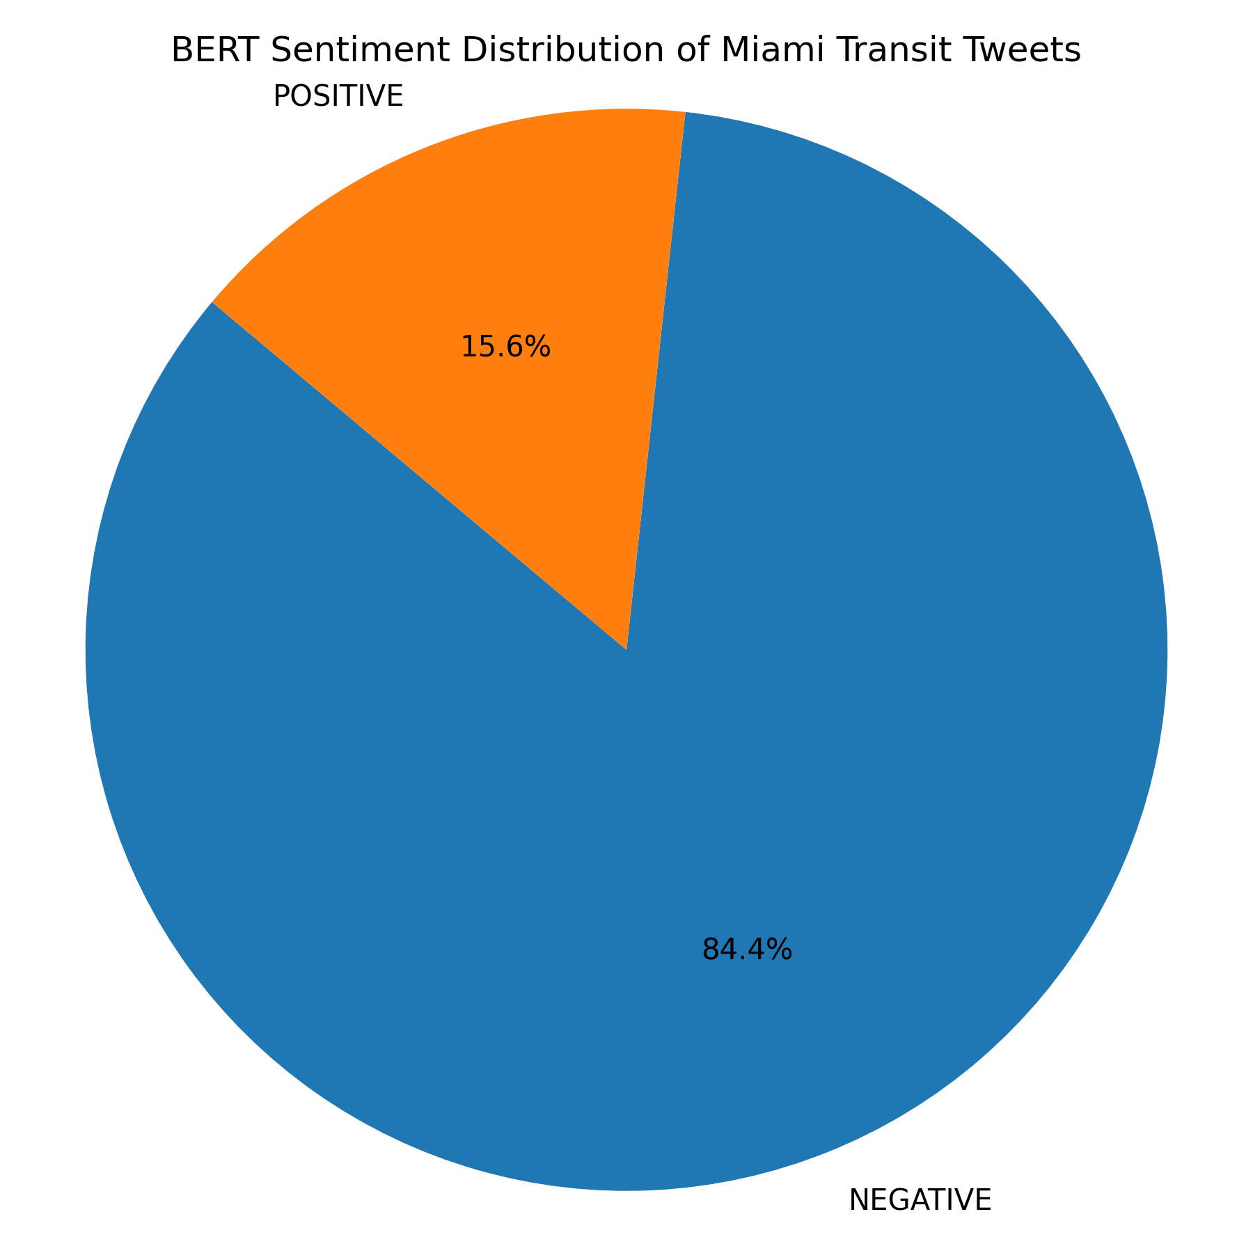
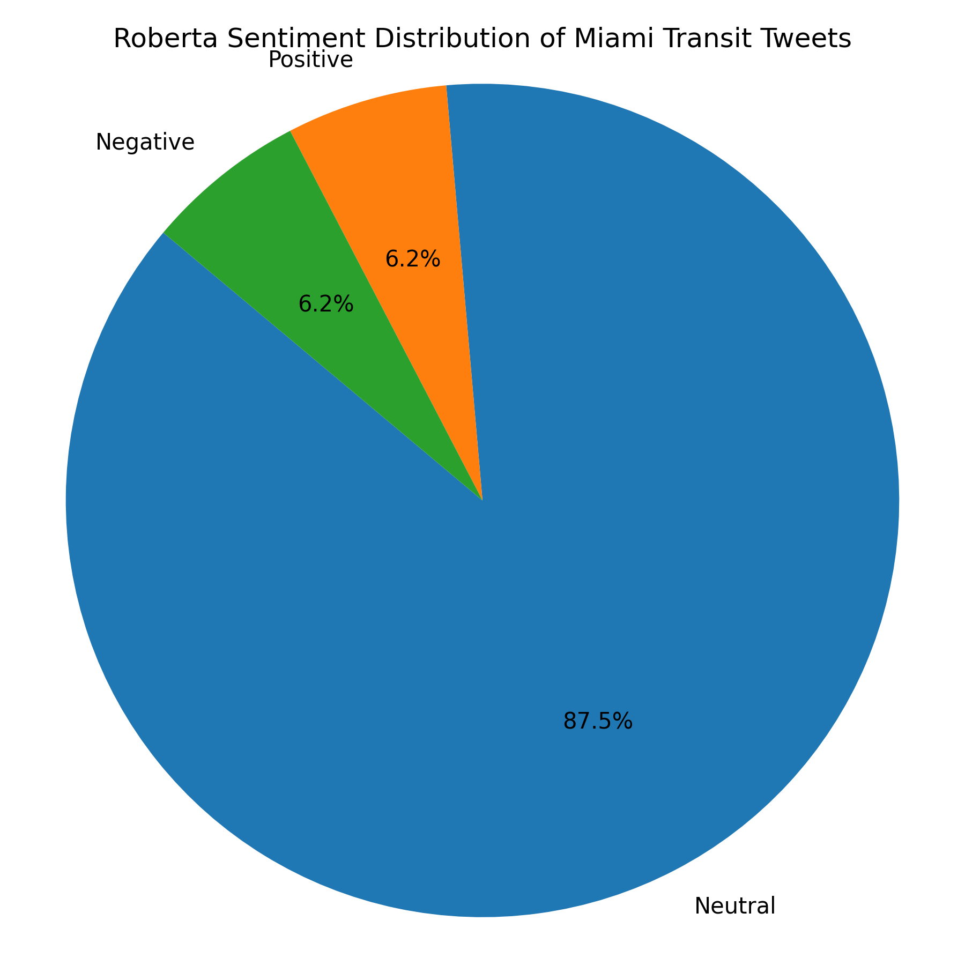
Result - Manual Analysis
Result - BERT
Result - ROBERTA
Result - TextBlob
Result - VADER

Slide 15
Thank You

